Slide 1
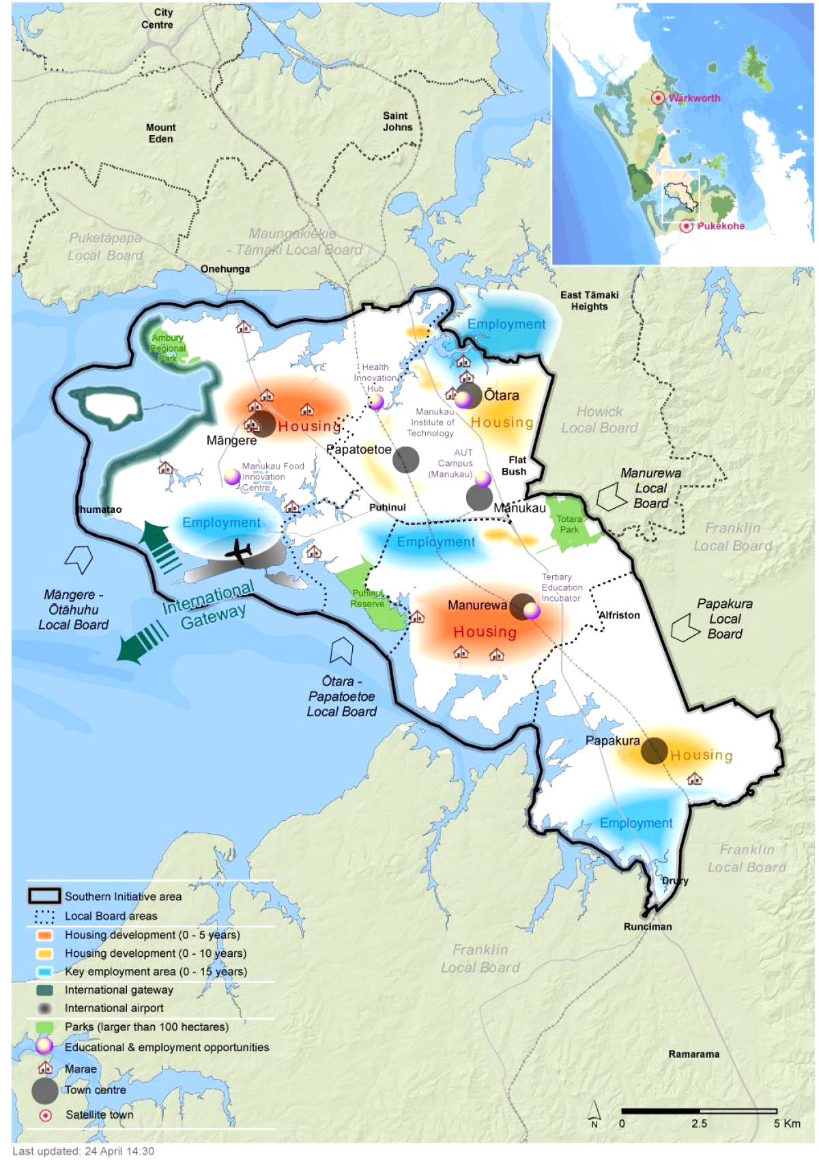
South Auckland
Cherie, Jessie & Dharshna
Notes:
Images retrieved from: https://maps-auckland.com/south-auckland-map
<div>Icons made by <a href="https://www.freepik.com" title="Freepik">Freepik</a> from <a href="https://www.flaticon.com/" title="Flaticon">www.flaticon.com</a></div>

Slide 2
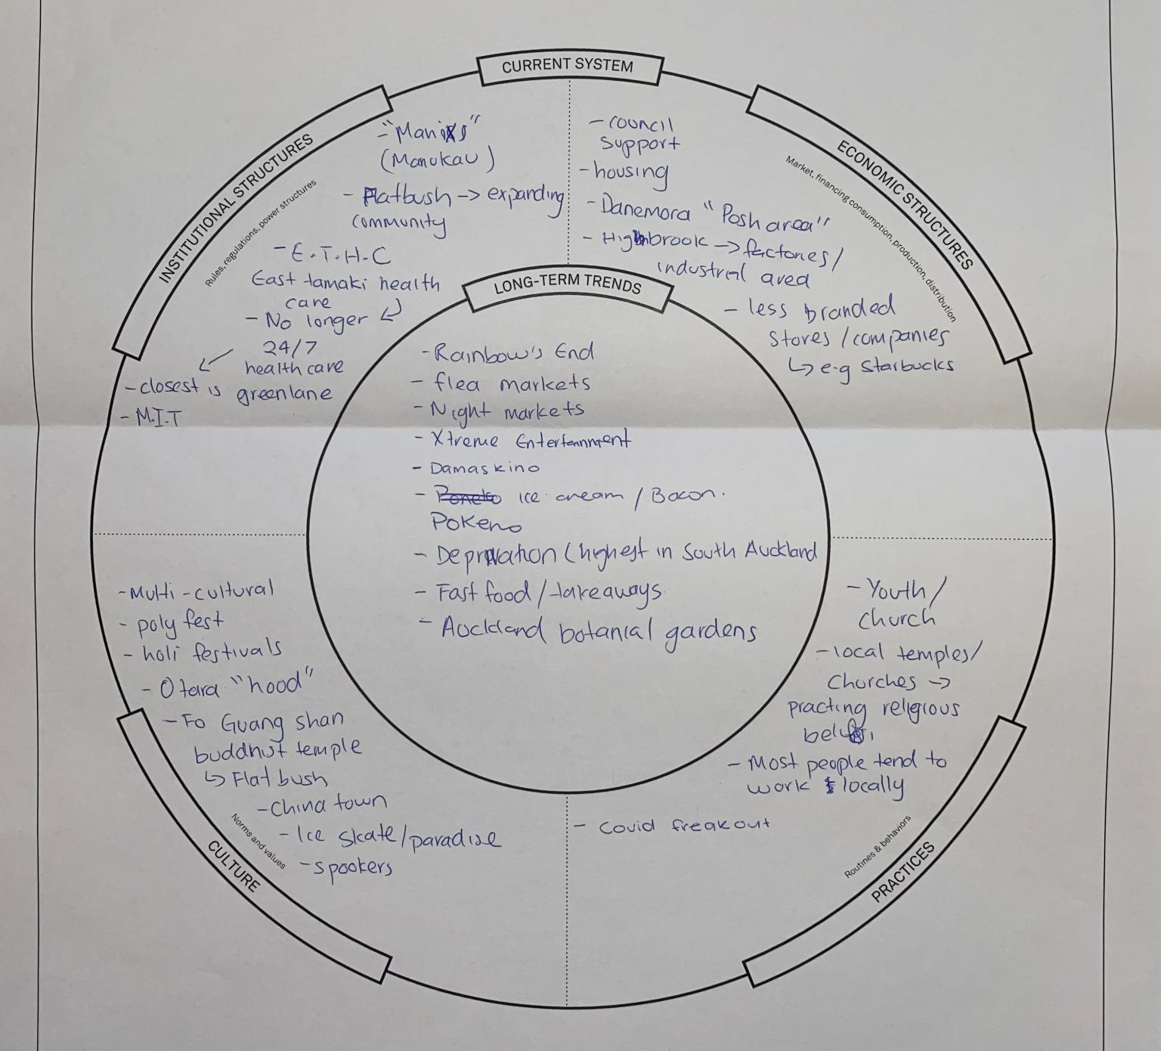
Framing the system
In step 1 of our design process we framed the system using the rich context template.
Some key ideas we thought about are……
-South Auckland is a multicultural community (fairly large population)
-People tend to view South Auckland as a “low class area”, “dangerous”
-Along with being a multicultural community, South Auckland is home to many places/spaces of worship for different cultures and religions
-South Auckland has the highest rate of deprivation

Slide 3

Listening to the system
Interviews
Notes:
Images retrieved from: <div>Icons made by <a href="https://www.flaticon.com/authors/eucalyp" title="Eucalyp">Eucalyp</a> from <a href="https://www.flaticon.com/" title="Flaticon">www.flaticon.com</a></div>

Slide 4
Cherie’s Interview

Slide 5
Jessie’s Interview

Slide 6
Dharshna’s Interview

Slide 7
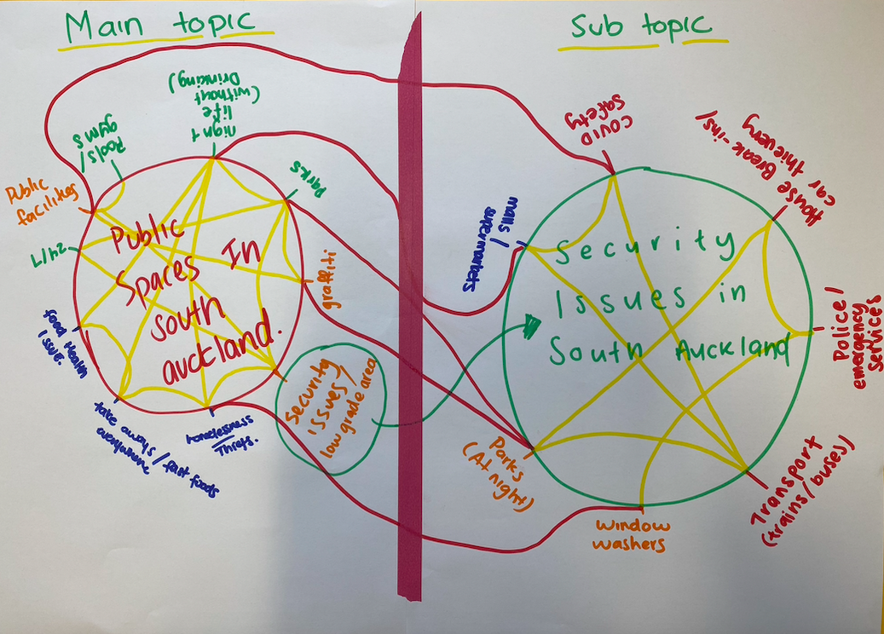
Section 3: Interconnected Circle Maps

Slide 8
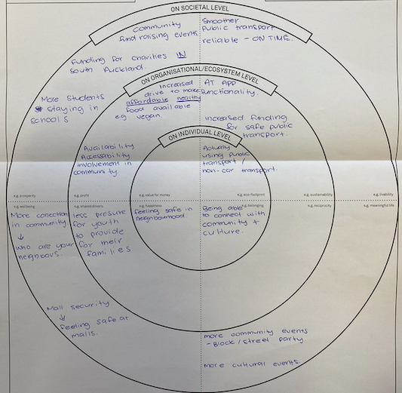
Section 4: Designing the desired future
Economical: Affordability of healthy food + more students staying in school
Ecological: Increase usage of public transport + more funding for local parks
Social: People gathering in local areas, especially without drinking
Psychological: More connection in neighbourhoods, safer communities

Slide 9

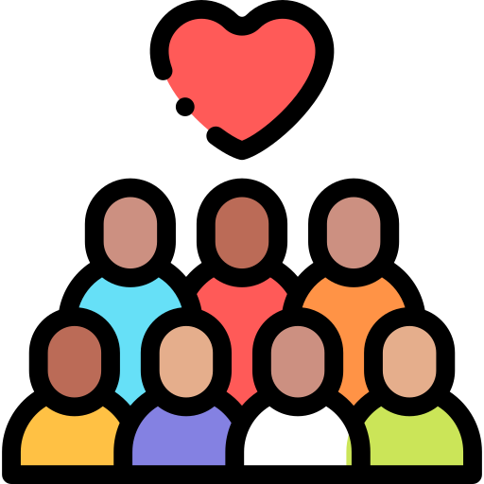
Thank You
Notes:
Images retrieved from: <div>Icons made by <a href="https://www.freepik.com" title="Freepik">Freepik</a> from <a href="https://www.flaticon.com/" title="Flaticon">www.flaticon.com</a></div>

